Slide 1
ADITYA – ELECTRICAL SUBSYSTEMS
K.SATHYANARAYANA

Slide 2
ADITYA – A JOURNEY THROUGH THREE DECADES
ERECTION OF ADITYA SUPPORT STRUCTURE, VACUUM VESSEL,TF COILS, POLOIDAL FIELD COILS AND ESSENTIAL DIAGNOSTICS WAS COMPLETED AROUND MIDDLE OF 1988
HYDRAULIC CONNECTIONS TO THE TF COILS, POLOIDAL FIELD COILS & HYDROSTATIC PRESSURE TESTS WAS COMPLETED BY THE END OF 1988
OTPS ( DYNAMIC & WAVESHAPING ) & VFPS POWER SYSTEM WAS TESTED ON DUMMY LOAD

Slide 3
ADITYA – A JOURNEY THROUGH THREE DECADES
TF COILS ALONGWITH HYDRAULIC COOLING TESTING WITH TFPS WAS CARRIED OUT
OTPS IN DYNAMIC MODE WAS TESTED ON OHMIC COILS AND VFPS WAS TESTED ON VERTICAL COILS
INTEGRATED TESTING ON THE TF, OT AND VF COILS WAS INTITATED
DURING TEST OF OTPS WITH WAVESHAPING ON OHMIC COILS A ELECTROMECHANICAL FAULT OCCURED IN THE 60MVA TRANSFORMER

Slide 4
ADITYA – A JOURNEY THROUGH THREE DECADES
NO RELIABLE QUICK SOLUTION TO MITIGATE THE FAULT IN THE 60MVA TRANSFORMER WAS IN SIGHT
TO OVERCOME THE SET-BACK A 250KJ CAPACITOR BANK WAS AUGMENTED TO TEST & COMMISSION ADITYA
MODULE UNIT ENERGY STORAGE CAPACITORS HITHERTO USED IN A BASIC EXPERIMENT “ BETA “ WERE REDEPLOYED IN ADITYA TO ENERGISE THE OHMIC AND VF COIL SYSTEMS

Slide 5
ADITYA – A JOURNEY THROUGH THREE DECADES
HIGH VOLTAGE HIGH CURRENT IGNITRONS WERE PROCURED
A STAND-ALONE TFPS CAPABLE OF ( 5KA CW & 15KA PULSED-3S) ENERGISING THE TFCOILS WAS ALSO PROCURED
ADITYA WAS THEN SUCCESSULLY TESTED AND COMMISSIONED WITH THE AUGMENTED SUBSYSTEMS WITH THE FIRST PLASMA DISCHARGE ON 5TH SEPTEMBER 1989

Slide 6
ADITYA – ELECTRICAL SUBSYSTEMS
ADITYA PULSE POWER SYSTEMS (APPS)
OHMIC & VERTICAL COIL CAPACITOR BANK BASED PULSED POWER SYSTEMS
CW & PULSED ( 3 SECONDS ) 12KA STAND ALONE TFPS
CW / PULSED 2.45 GHZ ECR POWER SYSTEM
PULSED POWER SYSTEMS CONFIGURED TO SUIT CALIBRATION OF MAGNETIC DIAGNOSTICS OF ADITYA-U

Slide 7
ADITYA – ELECTRICAL SUBSYSTEMS
D.C. GLOW DISCHARGE CLEANING POWER SUPPLY
PULSED OHMIC DISCHARGE POWER SYSTEM USED FOR ECR + PDC DISCHARGE CLEANING SYSTEM
GROUNDING MESH IN STAR CONFIGURATION
STAND ALONE EARTH LOOP SYSTEM TO DETECT (ON LINE /OFF LINE) EARTH LOOP FAULTS BETWEEN DIAGNOSTICS & VACUUM VESSEL , DIAGNOSTICS & STRUCTURAL ELEMENTS OF ADITYA & ADITYA-U

Slide 8
SYSTEM PARAMETERS OF ADITYA
MAJOR RADIUS – 0.75M
MINOR RADIUS - 0.25M
ECR FREQUENCY – 2.45GHZ +/- 0.1GHZ.
MICROWAVE POWER ( LAUNCHED ) – TE-10 ~0.8KW
MICROWAVE PULSE DURATION – CW AND PULSED SYSTEM (SEVERAL HUNDRED MILLISECONDS)
LIMITER PLASMA – CIRCULAR
NEUTRAL GAS – HYDROGEN
OHMIC PHASE - APPS & CAPACITOR BANK
STRAY VERTICAL MAGNETIC FIELD – ~10 GAUSS

Slide 9
DIMENSIONS DETAILS OF TR, BV & FFB COILS
Major Axis
382
BV1 (T)
1648
TR5 (T)
1639.9
BV2 (T)
1226
1050
1220.5
395.3
TR2 (T)
TR3 (T)
725
1534
838
300
FFB Inner (T)
FFB Outer (T)
TR4 (T)
223.7
450
600
1187.5
1070
630
TR1
390
375
R=0
0
750
Z = 0
Vacuum
Vessel
1070
- 390
- 630
- 375
- 838
450
- 600
Buckling
Cylinder
FFB Inner (B)
FFB Outer (B)
TR4 (B)
- 1187.5
TF
Coil
395.3
TR2 (B)
- 725
1534
- 1159.5
1226
TR3 (B)
1648
- 1050
TR5 (B)
382
BV1 (B)
BV2 (B)
1639.9
All Dimensions are in mm

Slide 10
ADITYA – U Tokamak: Inductance Matrix
 | TR1 | TR2U | TR3U | TR4U | BV1U | BV2U | TR2D | TR3D | TR4D | BV1D | BV2D | TRU5 | TRD5 | DINT | DOUT | DINB | DOUB
TR1 | 4.810
TR2U | 0.279 | 2.862
TR3U | 0.028 | 0.045 | 0.064
TR4U | 0.037 | 0.046 | 0.032 | 0.132
BV1U | 0.148 | 1.299 | 0.040 | 0.041 | 3.642
BV2U | 0.127 | 0.227 | 0.117 | 0.197 | 0.238 | 3.808
TR2D | 0.174 | 0.023 | 0.008 | 0.015 | 0.017 | 0.051 | 1.680
TR3D | 0.027 | 0.009 | 0.004 | 0.008 | 0.007 | 0.027 | 0.043 | 0.050
TR4D | 0.035 | 0.017 | 0.008 | 0.016 | 0.013 | 0.054 | 0.044 | 0.032 | 0.102
BV1D | 0.108 | 0.018 | 0.007 | 0.013 | 0.013 | 0.043 | 1.540 | 0.038 | 0.040 | 2.270
BV2D | 0.124 | 0.056 | 0.027 | 0.056 | 0.046 | 0.208 | 0.236 | 0.117 | 0.204 | 0.240 | 3.439
TR5U | 0.006 | 0.010 | 0.005 | 0.009 | 0.011 | 0.159 | 0.002 | 0.001 | 0.002 | 0.002 | 0.009 | 0.011
TR5D | 0.006 | 0.003 | 0.001 | 0.003 | 0.002 | 0.010 | 0.011 | 0.006 | 0.010 | 0.011 | 0.150 | 0.000 | 0.009
DINT | 0.137 | 0.049 | 0.005 | 0.006 | 0.027 | 0.022 | 0.008 | 0.002 | 0.004 | 0.006 | 0.013 | 0.001 | 0.001 | 0.063
DOUT | 0.081 | 0.073 | 0.030 | 0.041 | 0.055 | 0.124 | 0.024 | 0.011 | 0.019 | 0.019 | 0.062 | 0.005 | 0.003 | 0.015 | 0.193
DINB | 0.127 | 0.009 | 0.002 | 0.004 | 0.006 | 0.012 | 0.037 | 0.005 | 0.006 | 0.023 | 0.023 | 0.001 | 0.001 | 0.004 | 0.008 | 0.043
DOUB | 0.078 | 0.027 | 0.011 | 0.019 | 0.020 | 0.061 | 0.065 | 0.032 | 0.041 | 0.051 | 0.127 | 0.003 | 0.006 | 0.008 | 0.032 | 0.015 | 0.146

Slide 11
OHMIC & VERTICAL COIL CAPACITOR BANK BASED PULSED POWER SYSTEMS
MODULE UNIT ENERGY STORAGE CAPACITOR OF 700μF / 5kVWDC USED FOR BUILDING THE OHMIC & VERTICAL COIL SLOW CAPACITOR BANKS
IGNITRONS BK-488A AND BK-496 USED FOR HIGH CURRENT / HIGH VOLTAGE SWITCHES
IGNITRONS SWITCHED BY HIGH CURRENT IGNITOR PULSE WITH STRETCHED PULSE LENGTH
CONCEPT OF POWER CROBAR USED IN THE DESIGN ALONGWITH ACTIVE CROWBAR IGNITRONS
CONSTANT VOLTAGE CHARGING USED FOR CHARGING ALL THE CAPACITOR BANKS

Slide 12
SALIENT DESIGN FEATURES OF OHMIC CAPACITOR BANK
S-1, S-2 AND S-3 ARE IGNITRONS BK-488A
S-4 2 NOS. IGNITRONS 496
FAST BANK – C0 – 680μF / 10kVWDC
SLOW BANK – 1 – C1 – 2.4mF / 8kVWDC
SLOW BANK – 2 – C2 – 36 mF / 5kVWDC
LOAD INDUCTANCE – 9.7 mH
LOAD RESISTANCE – 10 MILLIOHMS
POWER CROWBAR CONCEPT USED & CROWBAR IGNITRONS USED BK-496

Slide 13
SCHEMATIC OF 250KJ CAPACITOR BANK FOR OHMIC SYSTEM

Slide 14
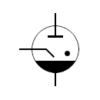
BLOCK DIAGRAM OF IGNITRON TRIGGER SCHEME
T_{X}
T_{X}
R_{x}
R_{x}
Bias Power supply
Floating Bias Power supply
Isolation Transformer
Timer Module
Driver and T_{X}
R_{x}
DAQ
F.O. Cable
Anode
TTL LINE DRIVER
High Voltage Trigger Pulse Transformer
Ignitor
IGNITRON
Co-axial cable
BK-488A / BK-496
SCR / THYRISTOR
DC High Voltage Power Supply with RC network 800V DC.
Input 1φ, 50H_{Z}
230v,~
High Voltage Isolation

Slide 15
SCHEMATIC OF OHMIC SYSTEM ALONG WITH TRIGGER SYSTEM

Slide 16
SECONDARY VACUUM LOOP VOLTAGE MEASURED BY FLUX LOOP AND PRIMARY CURENT

Slide 17
Loop voltage comparison in vacuum shot

Slide 18
Discharge comparison with & without additional capacitors

Slide 19
SALIENT DESIGN FEATURES OF VERTICAL FIELD & PDC CAPACITOR BANK
SWITCHING IGNITRON – BK 488A
CROWBAR IGNITRON - BK-496
FAST BANK – 500 μF / 10kV
SLOW BANK- 14 mF / 10kV
PDC – 120 μF / 10kV
PDC – SWITCHING IGNITRON – BK488A
PDC USED IN STAND ALONE MODE WITH STAND ALONE TFPS

Slide 20
FRONT VIEW OF VF CAPACITOR BANK

Slide 21
FRONT VIEW OF PDC POWER SYSTEM

Slide 22
SECOND HARMONIC ECR EXPERIMENTS IN ADITYA
NEED FOR ECR AND ECR + PDC DISCHARGE CLEANING FOR BETTER WALL CONDITONING – LEADING TO LOW “Z” IMPURITY IN PLASMA DISCHARGES
TO INITIATE SECOND HARMONIC ECR ASSISTED PLASMA START-UP IN ADITYA & DISCHARGE CLEANING EXPERIMENTS
AS AN OFFSHOOT, THE EXPERIMENTAL STUDIES AND UNDERSTANDING WAS SHARED ON VARIOUS NATIONAL AND INTERNATIONAL FORA

Slide 23
BLOCK DIAGRAM OF PULSED MICROWAVE SOURCE
H I G H V O L T A G E D E C K
SCREEN GRID POWER SUPPLY
FILAMENT
POWER SUPPLY
MODULATOR
POWER SUPPLY
LOW POWER ELECTRONICS
FIBRE OPTIC RECEIVER
Fibre optic cable
MODULATOR SWITCHING TETRODE BIAS
CONTROL GRID POWER SUPPLY
CONTROL ELECTRONICS
Microwave output @2.45Ghz
Pulsed High Voltage
FILAMENT POWER SUPPLY OF MAGNETRON
HIGH VOLTAGE POWER SUPPLY WITH PROTECTION
MAGNETRON MODEL
2M1074-8250

Slide 24
ADITYA – TOKAMAK WITH ECR SYSTEM
ECR SYSTEM
ECR SYSTEM

Slide 25
EXPERIMENTAL SETUP ALONGWITH MICROWAVE POWER AND ELECTRON DENSITY

Slide 26
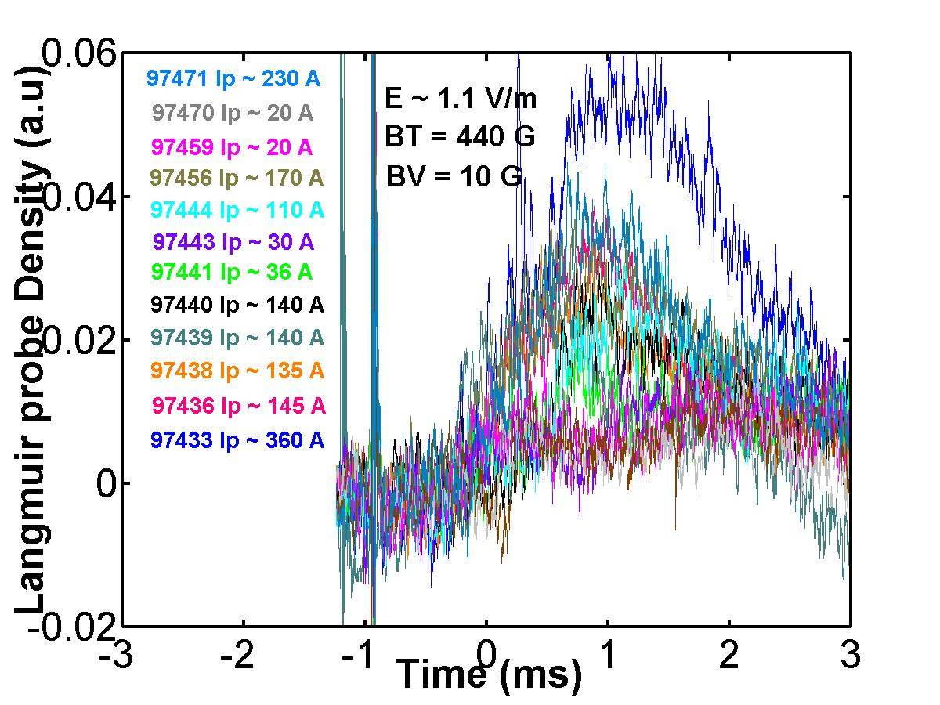
Temporal Evolution of Electron Density Vs. Pressure

Slide 27
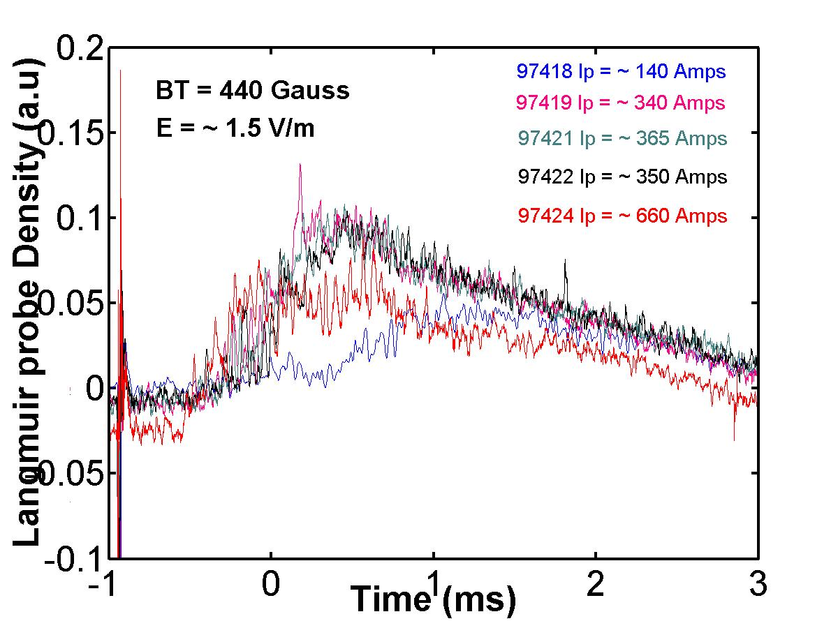
Temporal Evolution of Electron Density Vs. Pressure

Slide 28
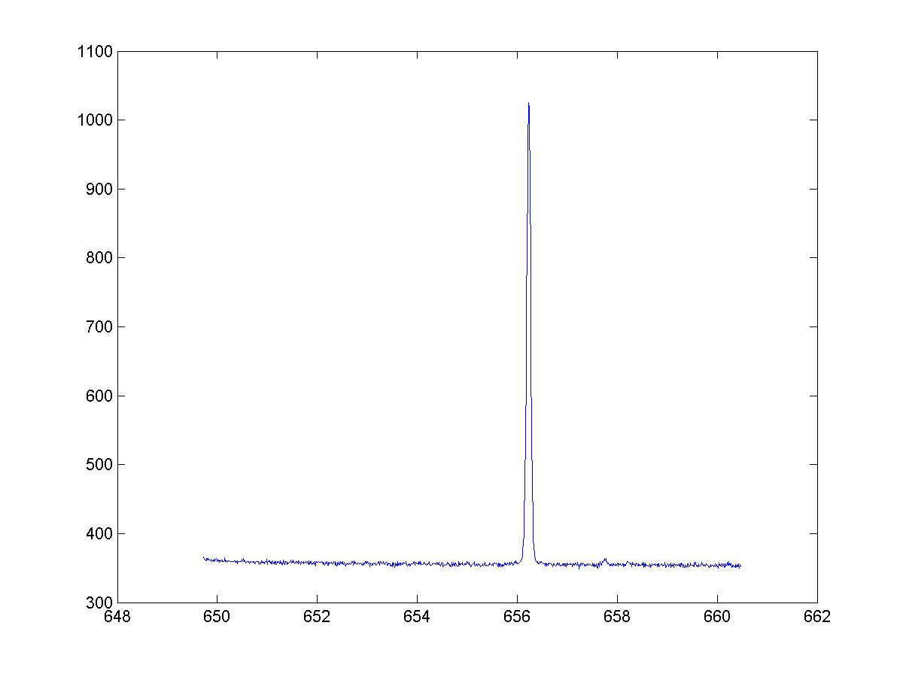
Shot No: 97495 – MTS (4)

Slide 29
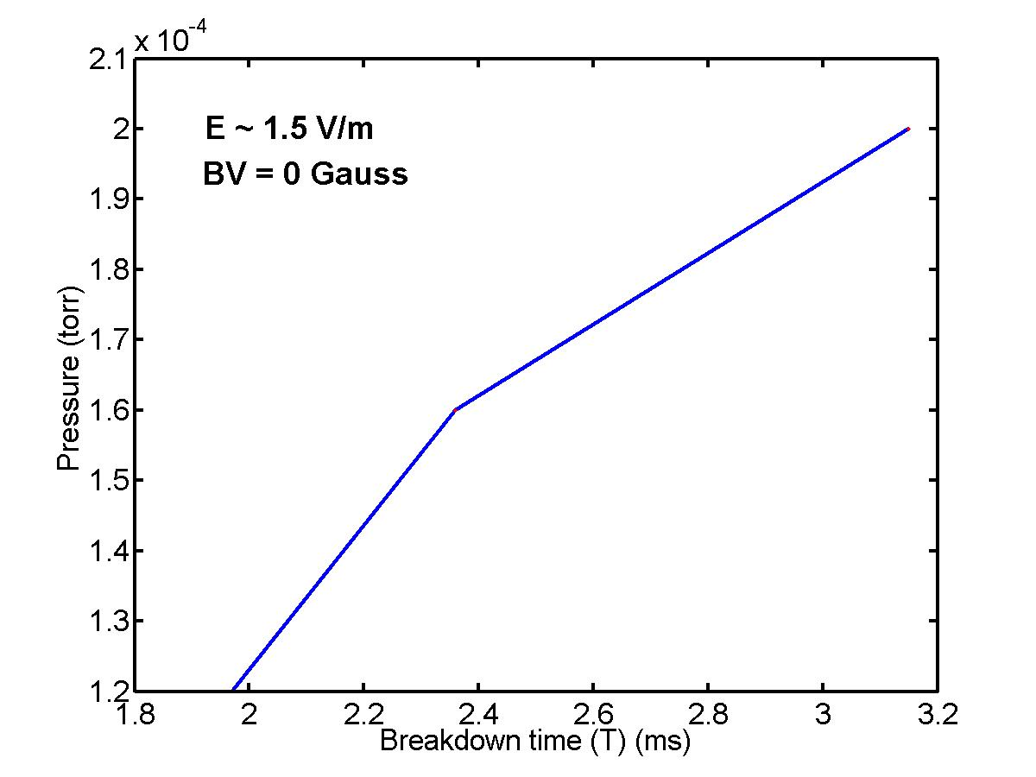
Neutral Break-Down measurements Vs Pressure

Slide 30
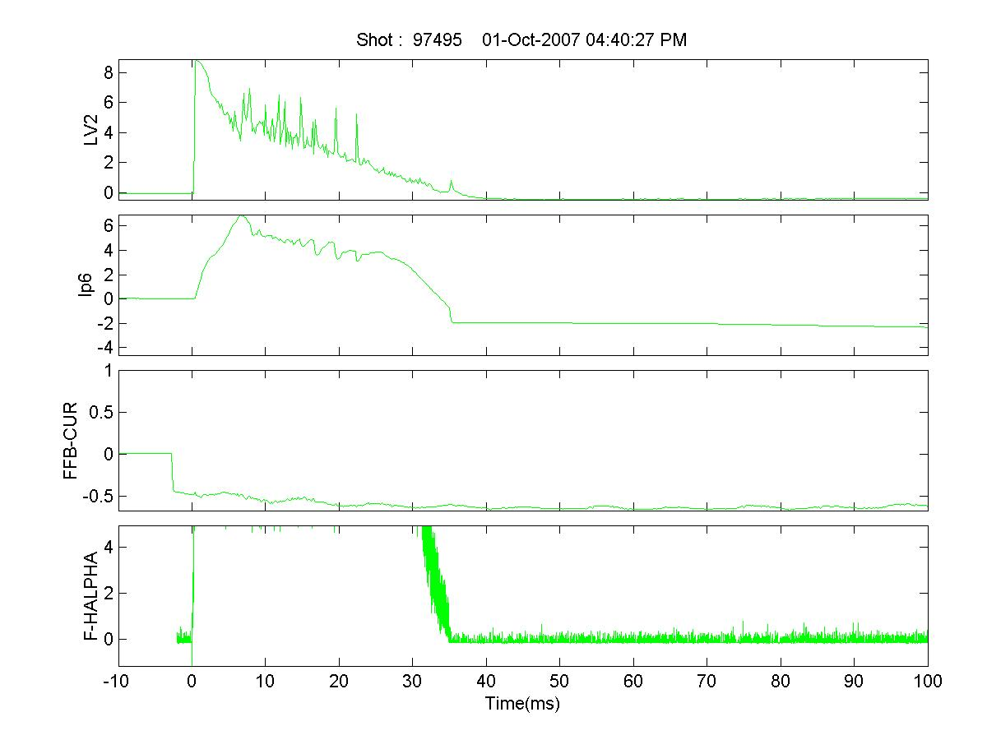
Shot No: 97495 – ECR- ON

Slide 31
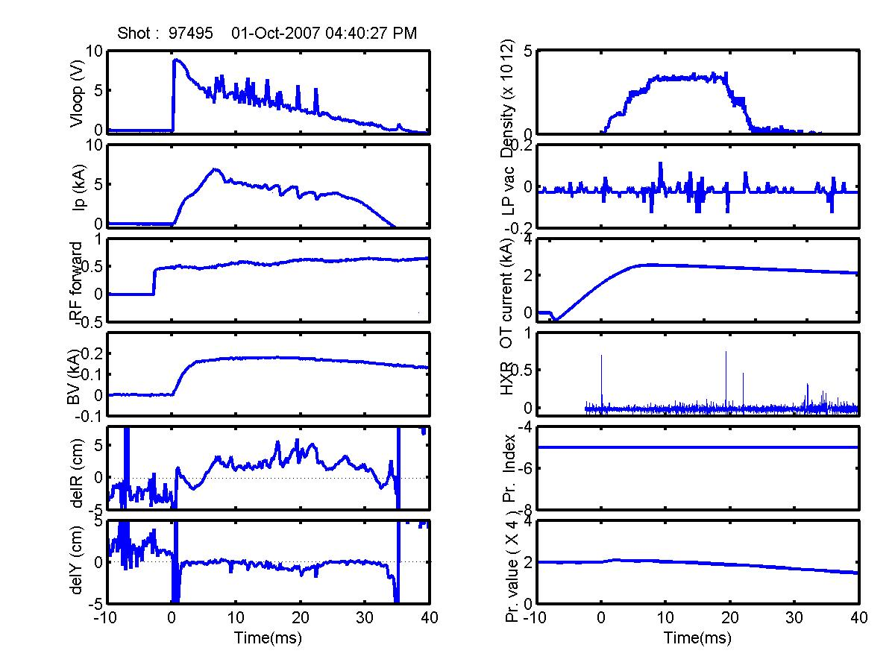
Typical ECR Assisted Start-up Plasma Discharge

Slide 32
Multi-track (H-alpha) results

Slide 33
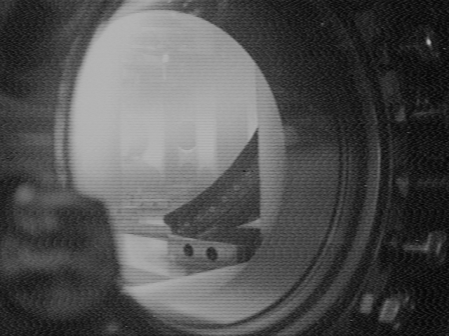
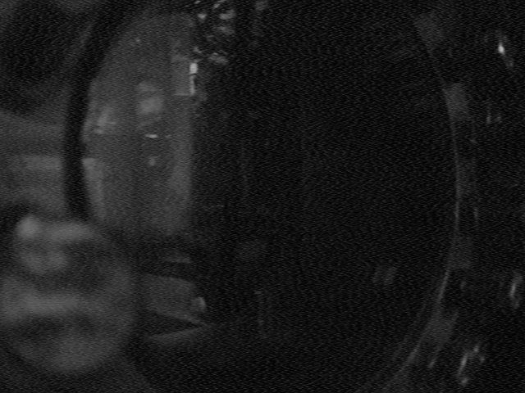
CCD Camera Images of Evolution of the Plasma Discharge

Slide 34
FRONT VIEW OF ECR POWER SUPPLY

Slide 35
CONCLUSION
THE ELECTRICAL SUBSYSTEMS MADE OPERATIONAL 3 DECADES BACK FOR ADITYA ARE STILL FUNCTIONAL AS OF EVEN DATE FOR ADITYA -U
ELECTRICAL SUBSYSTEMS FOR ADITYA-U HAVE BEEN MADE MORE RELIABLE
AUTOMATION OF THE VARIOUS ELECTRICAL SUBSYSTEMS HAVE BEEN INITIATED

Slide 36
ACKNOWLEDGEMENTS VACUUM GROUP ATOG &
R.L.Tanna, S.B.Bhatt, N.Ramasubramanian, Manoj Kumar, R.Manchanda, Santanu Banerjee, P.K.Atrey, B.K.Shukla, P.S.Bawankar, K.M.Patel, J.M.Sonara,KetanM.Patel, Vishnu Chaudhary, Pragnesh.D, Dharmesh.P, Sanjay Kulkarni, Joydeep Ghosh,Y.C.Saxena & Aditya Team

